Slide 1
Assessment of the Efficiency of the Administrative Mechanism
Minnesota Council for HIV/AIDS Care and Prevention
Evaluation of Part A – Fiscal Year 2020 (March 1, 2020 – February 28, 2021)
July 13, 2021

Slide 2
What is an AAM?
The AAM is a review of how quickly and well the Part A recipient carries out the processes needed to contract with and pay providers for delivering HIV-related services, so that that the needs of people with HIV/AIDS throughout the Part A service area are met. Emphasis is on ensuring services to PWH and to communities with the greatest need for Ryan White services.
Quick Reference Handout 7.2: Assessment of the Administrative Mechanism
https://targethiv.org/planning-chatt/training-guide-module7
Notes:
How quickly and well the Part A recipient carries out the processes needed to contract with and pay providers for delivering HIV-related services so that that the needs of people with HIV/AIDS throughout the Part A service area are met.
Emphasis is on ensuring services to people with HIV and to communities with the greatest need for Ryan White services.

Slide 3
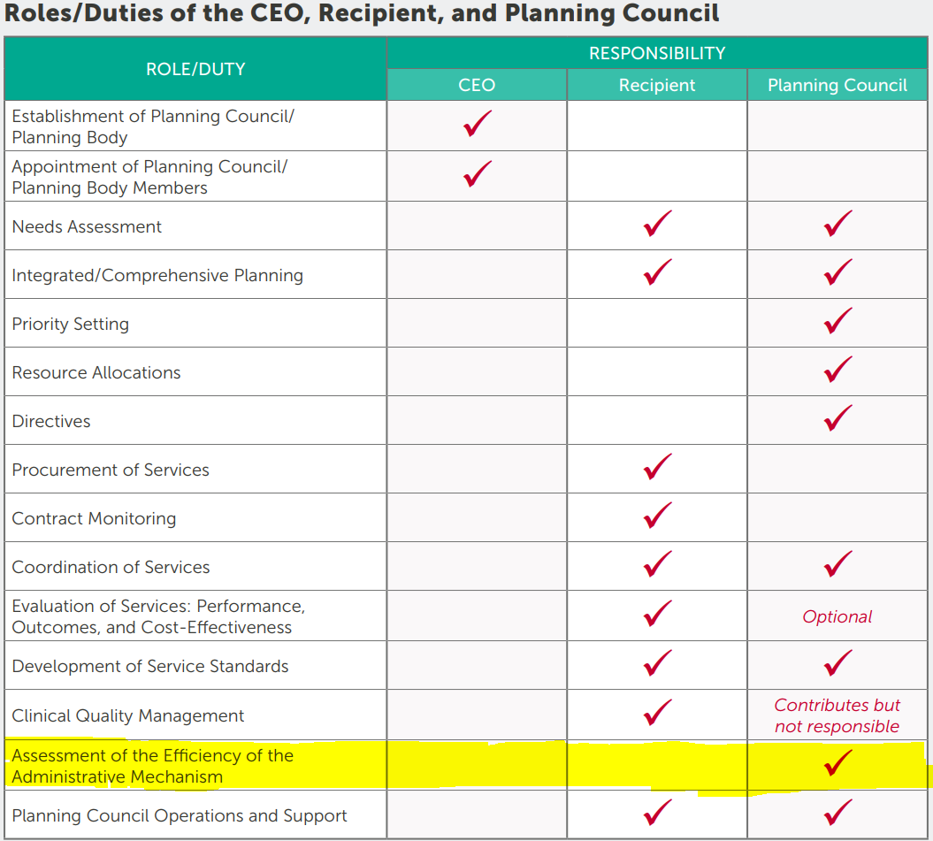
Ryan White HIV/AIDS Program Part A Planning Council Primer
Notes:
It is a legislative requirement and a standard of membership for our council.

Slide 4
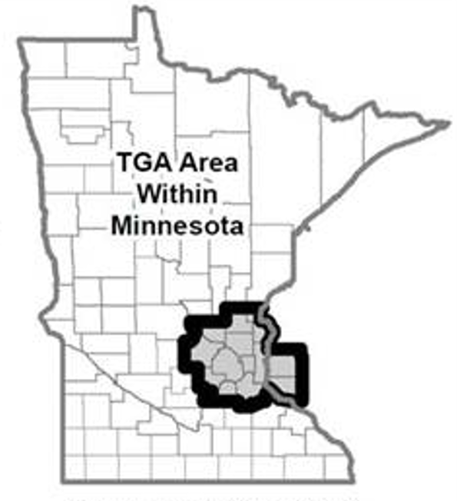
Assessing the Minneapolis/St. Paul TGA
Serves the following states and counties:
Minnesota: Anoka County, Carver County, Chisago County, Dakota County, Hennepin County, Isanti County, Ramsey County, Scott County, Sherburne County, Washington County, and Wright County
Wisconsin: Pierce County and St. Croix County

Slide 5
Assessment of the Efficiency of the Administrative Mechanism
The planning council is responsible for evaluating how rapidly Ryan White HIV/AIDS Program Part A funds are allocated and made available for care. This involves ensuring that funds are being contracted for quickly and through an open process, and that providers are being paid in a timely manner.
Ryan White HIV/AIDS Program Part A Planning Council Primer
Notes:
Evaluating how rapidly Ryan White HIV/AIDS Program Part A funds are allocated and made available for care.
Funds are being contracted for quickly and through an open process, and that providers are being paid in a timely manner.

Slide 6
This is the only council task that involves looking at procurement and contracting, which are recipient responsibilities.
Quick Reference Handout 7.2: Assessment of the Administrative Mechanism
https://targethiv.org/planning-chatt/training-guide-module7
Notes:
Procurement and contract management are solely the recipient’s responsibility and the council cannot be involved in administration of the grant. This is the only situation in which the council considers issues related to procurement and fund administration.

Slide 7
Guidance from Ryan White HIV/AIDS Program Part A Planning Council Primer
Funds are being contracted for quickly and through an open process
Providers are being paid in a timely manner
Funds are used to pay only for services that were identified as priorities by the council
Amounts contracted for each service category are the same as the council’s allocations
Notes:
Using this guidance, the Needs Assessment and Evaluation Committee selected six objectives for the council to determine if they were met.

Slide 8
6 objectives to measure
Part A funds are contracted quickly to subrecipients
Subrecipients of Part A funds are selected through an open process
The recipient secured sufficient subrecipients for all service areas receiving allocations
Subrecipients are paid in a timely manner by Hennepin County
Part A funds are used to pay only services that were identified as priorities by the council
The amounts contracted for each service category are the same as the council’s allocations

Slide 9
How to complete the assessment
Objective
Measurement
Subrecipient Response Yes (n), No (n) (if applicable)
Recipient Response
This objective was met
Strongly Agree
Somewhat Agree
Somewhat Disagree
Strongly Disagree
Council Member Comments
Notes:
This is completed online. Paper copies can be requested by asking council staff. If you turn in a paper copy, please make sure council staff has counted you as completing the assessment.
The recipient response will also include if there are other funding sources (like Part B, state, and rebate) used to pay for services in the Part A jurisdiction.
The Hennepin County Integrated Planning and Analysis Survey Team is conducting this survey as an independent third-party to ensure confidentiality of the data. No individual will be identified and responses will not be linked to a specific person.

Slide 10
Completing the assessment
Council members will receive a link to the survey after today’s meeting
Council members review each objective and measurement and use the data in the subrecipient response (if applicable) and recipient response columns to determine if the objective was met
For any objective that you indicate strongly disagree or somewhat disagree, you should also include comments, addressing any strengths, weaknesses and specific recommendations for improvement
Notes:
The link will be sent from Internal Services.
Please do not hesitate to reach out if you have questions or difficulty filling out the AAM. Council staff is available, co-chairs of the Needs Assessment and Evaluation Committee or your mentor. By a show of hands, who is familiar with this document and is willing to assist other members.

Slide 11
Notes
Assessments are based on time-framed observations
Fiscal year 2020 (March 1, 2020 – February 28, 2021)
Names of providers are not included, it is aggregate data
Assessing the administrative mechanism is not meant to be an evaluation of the recipient or of individual subrecipients/service providers.
Council members are responsible for making specific recommendations for improvement if they find the existing mechanism is not working effectively

Slide 12
Anonymity
Responses to the assessment are collected by a third-party (Internal Services) and aggregate data is returned to council staff. No names or identifying information are linked to any responses.

Slide 13
Final steps
Council members will have three weeks to complete the online survey
Hennepin County Ryan White Program reviews the report for improvements
Results of the assessment and the plan for improvement will be included in the Part A grant application and presented to the council
Results from this year and past years available at http://www.mnhivcouncil.org/documents.html (Part A Recipient Documents)

Slide 14
Carissa Weisdorf
carissa.weisdorf@hennepin.us, 612-348-6837

